Slide 1


Computer Organization and Architecture
Lecture6 MIPS ISA
Jihe Wang
wangjihe@nwpu.edu.cn

Slide 2
Today's
Topic
00
Today's Topics
01. Register and Memory Orgnaztion of MIPS
02. Typical Instructions
03. Machine Language
04. Programming with MIPS instructions

Slide 3
1.1
Register Orgnzation
32 general purpose registers:r0-r31
A 64-bit Register for Multiply and divide
A 32-bit Register for the program address
PC

Slide 4
1.1
Memory Orgnaztion
The space allocated on stack by a procedure is termed the activation
record (includes saved values and data local to the procedure) – frame
pointer points to the start of the record and stack pointer points to the
end – variable addresses are specified relative to $fp as $sp may
change during the execution of the procedure
$gp points to area in memory that saves global variables
Dynamically allocated storage (with malloc()) is placed on the heap
//main.cpp int a = 0; //global initialized area char *p1; //global uninitialized area main() { int b; //stack char s[] = “abc”; //stack char *p2; //stack char *p3 = “123456”; // 123456 in static, p3 in stack static int c =0； globle initialized area p1 = (char *)malloc(10); p2 = (char *)malloc(20); // allocated spaces are in heap strcpy(p1, “123456”); //123456 in static, compiler could use a same place with p3. }
Stack
Dynamic data (heap)
Static data (globals)
Text (instructions)

Slide 5
1.2
Instruction Format
OPCOD
OPERAND
…
OPERAND
The OPCOD defines the operation of the instruction, such as addition, subtraction, data transfer, etc.
The OPERANDs designate the operate object of the OPCOD, which are the index of the register file, the address of memory, etc.
Both the OPCOD and OPERAND are represented in binary.

Slide 6
2
Typical Instructions of MIPS
Arithmetic Instructions
Logical Instructions
Load/Store Instructions
Comparison Instructions
Branch Instructions
Jump Instructions
Other Instructions

Slide 7
2.1
Arithmetic Instructions
add rd, rs, rt
addu rd, rs, rt
addi rd, rs, imm
addiu rd, rs, imm
sub rd, rs, rt
subu rd, rs, rt
mult rs, rt
multu rs, rt
mul rd, rs, rt #put the low-order 32 bits of the product into the register rd
div rs, rt
divu rs, rt
mfhi rd #rd<-hi
mflo rd #rd<-lo
mthi rs #hi<-rs
mtlo rs #lo<-rs

Slide 8
2.1
Arithmetic Instructions -Continued
madd rs,rt #(Hi,Lo)<-(rs X rt)+(Hi,Lo)
maddu rs,rt #(Hi,Lo)<-(rs X rt)+(Hi,Lo)
msub rs, rt#(Hi,Lo)<-(rs X rt)-(Hi,Lo)
msubu rs, rt#(Hi,Lo)<-(rs X rt)-(Hi,Lo)
clo rd,rs
clz rd,rs
#Count the number of leading ones (zeros) in the word in the register rs and put the result into register rd. If a word is all ones (zeros), the result is 32

Slide 9
2.2
Logical Instructions
and rd, rs, rt
andi rt, rs, imm
or rd, rs, rt
ori rt, rs, imm
xor rd, rs, rt
xori rt, rs, imm
nor rd, rs, rt
sll rd, rt, shamt
sllv rd, rt, rs
sra rd, rt, shamt
srav rd, rt, rs
srl rd, rt, shamt
srlv rd, rt, rs
left
arithmetic
Logical
right

Slide 10
2.3
Load/Store Instructions
sb rt, address (byte)
sh rt, address (half word)
sw rt, address
swc1 ft, address (Coprocessor 1)
sdc1 ft, address
swl rt, address
swr rt, address
sc rt, address
lui rt,imm
lh rt, address
lhu rt, address
lw rt, address
lwc1 ft, address
lwl rt, address
lwr rt, address
ll rt, address
double
Store Conditional
Load Linked

Slide 11
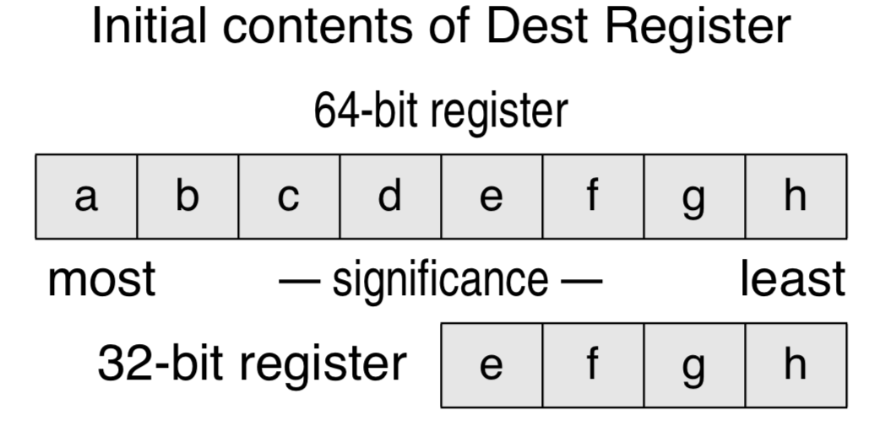
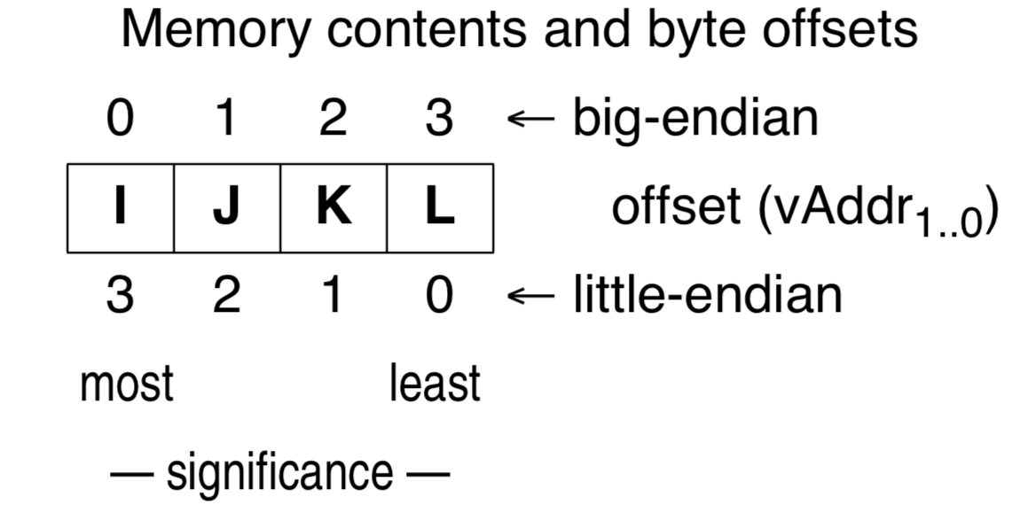
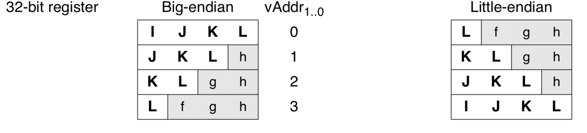
2.3
Load/Store Instructions: lwl $t0, vAddr
pointer
$t0
“X And 0” to set 0;
“X or 0” to keep X;
“X And 1” to keep X;
“X or 1” to set 1;

Slide 12
2.4
Comparison Instructions
slt rd, rs, rt
sltu rd, rs, rt
slti rt, rs, imm
sltiu rt, rs, imm
#Set rd if rs less than rt, otherwise clear rd
#Set rt if rs less than imm, otherwise clear rt

Slide 13
2.5
Branch Instructions
beq rs, rt, label
bne rs, rt, label
bgez rs, label
bgtz rs, label
blez rs, label
bltz rs, label
bgezal rs, label #in addition to conditional branch,
bltzal rs,label #store the PC into $ra (r31)
Notes:
To test a GPR then do a PC-relative conditional procedure call.

Slide 14
2.6
Jump Instructions
j target
jr rs #jump to the instruction whose address is
# in register rs
jal target #in addition to jump, store the PC to
# $ra (r31), subroutine call
jalr rs #jump to the instruction whose #address is in rs, save pc in ra(which defaults to 31)

Slide 15
3.3
Machine Language-Jump Instruction(J-Format)
J target
op
6
target
from the low order 26 bits of the jump instruction
26
00
32
4
PC
How about Jr instruction ?
Notes:
If-then-else code compilation

Slide 16
2.7
Other Instructions

Slide 17
2.8
Psuedo-instructions
abs rdest, rsrc
div rdest, rsrc1, rsrc2
divu rdest, rsrc1, rsrc2
mulo rdest, rsrc1, rsrc2
mulo rdest, rsrc1, rsrc2
neg rdest, rsrc
negu rdest, rsrc
not rdest, rsrc
rem rdest, rsrc1, rsrc2
remu rdest, rsrc1, rsrc2
rol rdest, rsrc1, rsrc2
ror rdest, rsrc1, rsrc2
li rdest, imm
sd rsrc, address
ush rsrc, address
usw rsrc, address
b label
beqz rsrc, label
bge rsrc1, rsrc2, label
bgeu rsrc1, rsrc2, label
bgt rsrc1, rsrc2, label
bgtu rsrc1, rsrc2, label
ble rsrc1, rsrc2, label
bleu rsrc1, rsrc2, label
blt rsrc1, rsrc2, label
bltu rsrc1, rsrc2, label
bnez rsrc. label

Slide 18
3
Machine Language-Instruction Format
6
5
5
5
5
6

Slide 19
3.1
Machine Language-Add Instruction(R-Format)
Instructions, like registers and words of data, are 32 bits long
Arithmetic Instruction Format (R format):
add
$t0
$s1
$S2
“add” can be replaced by other operations, such as sub, and, sllv, et. al.
op rs rt rd shamt funct
6
5
5
5
5
6
op 6-bits opcode that specifies the operation
rs 5-bits register file address of the first source operand
rt 5-bits register file address of the second source operand
rd 5-bits register file address of the result’s destination
shamt 5-bits shift amount (for shift instructions)
funct 6-bits function code augmenting the opcodeadd

Slide 20
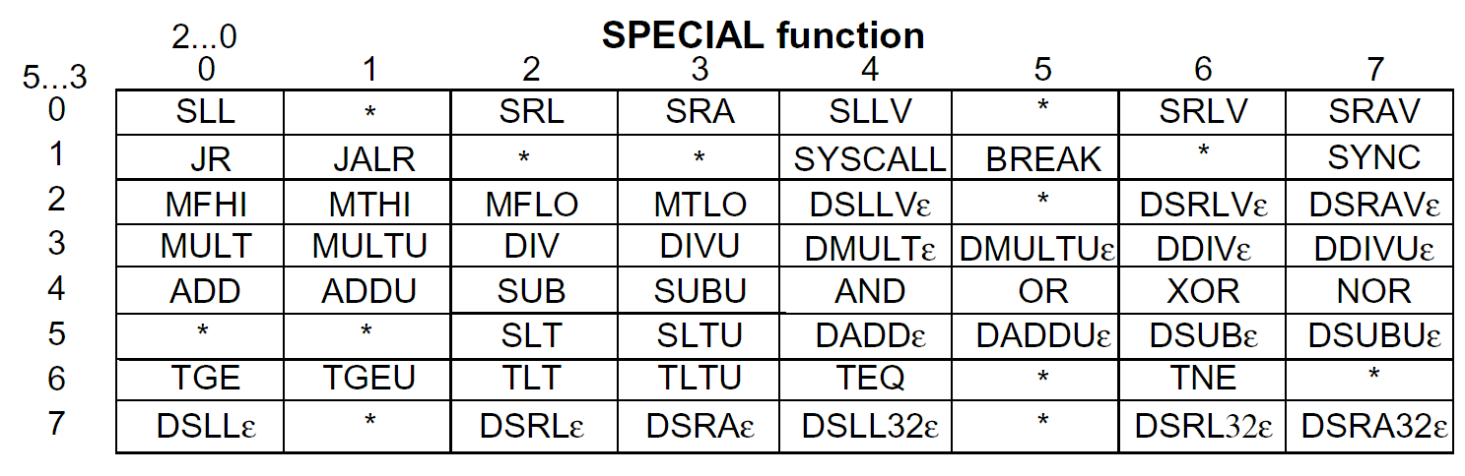
3.1
R-Type Encoding
[MIPS R4000 Microprocessor User’s Manual]
What patterns do you see? Why are they there?

Slide 21
3.2
Machine Language-Add Instruction(I-Format)
Load/Store Instruction Format (I format):
lw
$t0
24
$s2
“lw” can be replaced by other operations, such as st, bnz, ori, et. al.
op rs rt 16 bit offset
Memory
24₁₀ + $s2 =
0x120040ac
0xf f f f f f f f
$t0
0x120040ac
$s2
0x12004094
0x0000000c
0x00000008
0x00000004
0x00000000
data
word address (hex)
Notes:
destination address no longer in the rd field - now in the rt field
offset limited to 16 bits - so can’t get to every location in memory (with a fixed base address)

Slide 22
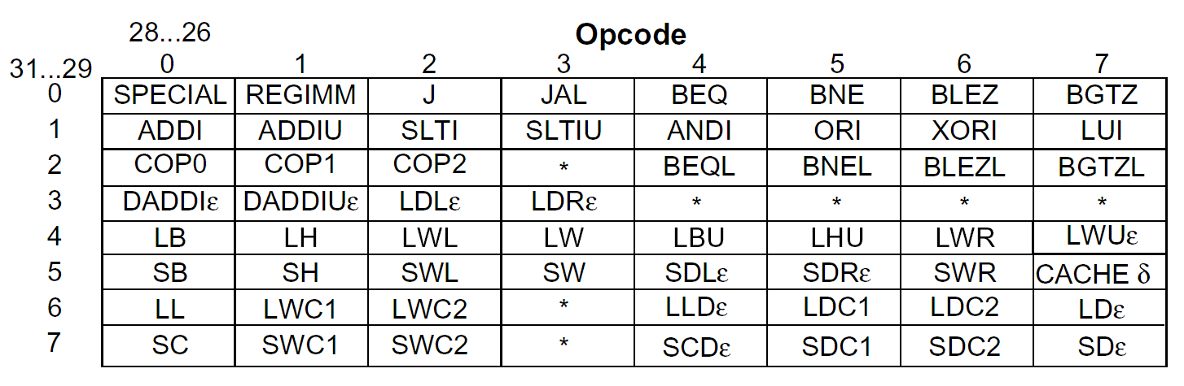
3.2
Reg-Immed Instruction Encoding
[MIPS R4000 Microprocessor User’s Manual]

Slide 23
3.4
MIPS Operand Addressing Modes
Register addressing – operand is in a register
op rs rt rd funct
Register
word operand
Base (displacement) addressing – operand is at the memory location whose address is the sum of a register and a 16-bit constant contained within the instruction
op rs rt offset
Memory
<<2
word or byte operand
base register
Register relative (indirect) with 0($a0)
Pseudo-direct with addr($zero)
Immediate addressing – operand is a 16-bit constant contained within the instruction
op rs rt operand

Slide 24
3.5
MIPS Instruction Addressing Modes
PC-relative addressing –instruction address is the sum of the PC and a 16-bit constant contained within the instruction
Pseudo-direct addressing – instruction address is the 26-bit constant contained within the instruction concatenated with the upper 4 bits of the PC
op rs rt offset
Memory
<<2
branch destination instruction
Program Counter (PC)
op jump address
Memory
<<2
|
|
jump destination instruction
Program Counter (PC)

Slide 25
4
Programming with MIPS Instruction
Arithmetic and logical operation
Use the corresponding arithmetic/logical instruction directly, if all the operands are in the registers (source operand can be immediate data).
If the source operand is located in memory, it should be moved into register by ‘lw’ before computing.
If the destination operand is a memory operand, it should be transferred to memory use ‘sw’ instruction after computing.
Some examples…

Slide 26
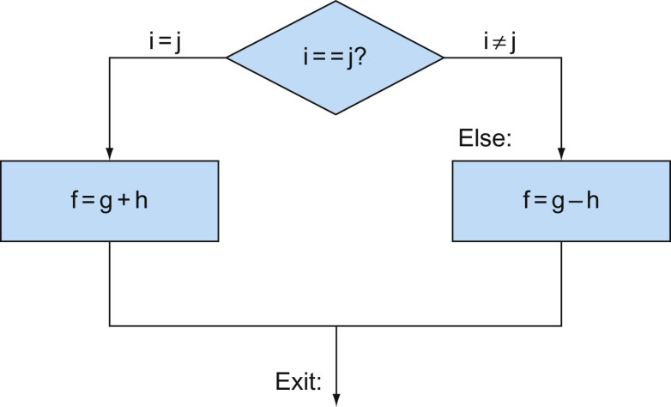
4
Programming with MIPS Instruction
if (i==j)
f=g+h;
else
f=f-h;
Suppose the 5 variables are in the register as follows:
i:$s0, j:$s1, f:$s2, g: $s3, h:$s4

Slide 27
4
Programming with MIPS Instruction
for (i=1000; i>=0;i--)
A[i]=A[i]+s;
Assumption:
The address of i: $s0;
address of A[0]:4
s:$s1;
Loop:
lw $s2, 4($s0)
add $s2, $s2, $s1
sw $s2, 4($s0)
subi $s0, $s0,4
bnez $s0, Loop

Slide 28
4
Programming-Procedure Call
Stack can be used to store and restore the context of the procedure call.

Slide 29
4
Programming-Stack
Located in Memory
Implementation
Was supported by ISA, specified instructions, such as push and pop instructions in 80X86
By software, such as in MIPS. $sp, which stores the address of top of the stack, should be updated by the programmer.

Slide 30
4
Programming-Procedure Call
Put the parameters in a place where the procedure can access them.
Transfer control to the procedure.
Acquire the storage resources needed for the procedure.
Perform the desired task.
Put the result value in a place where the calling program can access it.
Return the control to the point of origin, since a procedure can be called from several points in a program.

Slide 31
4
Programming-Register conventions

Slide 32
4
Programming-MIPS/GCC procedure call conventions
The first 4 parameters are transferred via register.

Slide 33
4
Programming- C example: swap
Assumption:
Swap can be called as a procedure
temp: $15
Parameters are stored in $a1 and $a2
$16 is used as scratch reg

Slide 34
4
Programming- MIPS: swap

